Slide 1

SCAFFOLDING WRITING
NICILT, Belfast
3rd February 2016

Slide 2
Objectives
To develop an understanding of how to support writing in the MFL classroom
To explore approaches and methodologies to scaffold writing

Slide 3

Vygotsky’s ZPD
Out of reach
Zone of proximal development
Learns through scaffolding
Current understanding
Can work unassisted

Slide 4
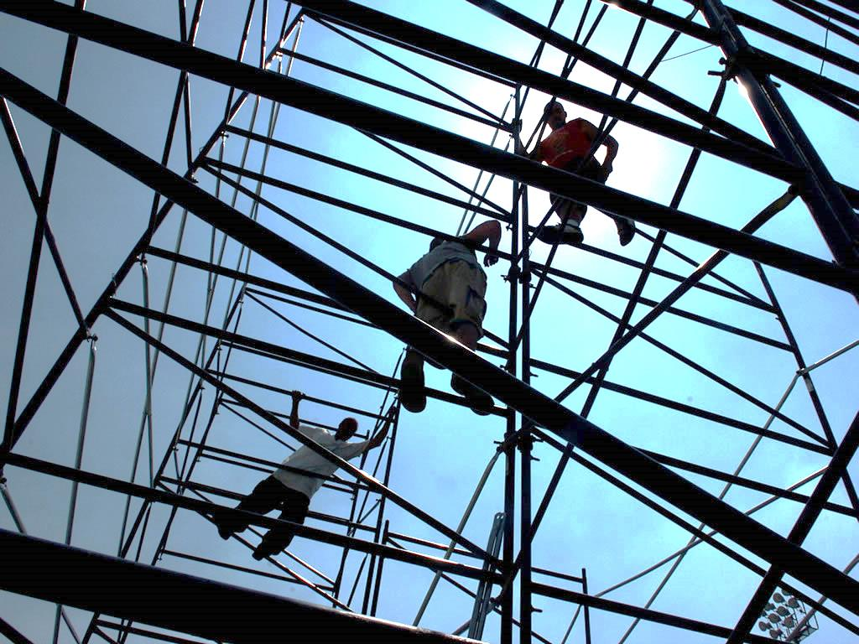
Task 1
Think, Pair, Share:
What is scaffolding?

Slide 5
What is scaffolding?
Instructional scaffolding is a learning process designed to promote a deeper level of learning. Scaffolding is the support given during the learning process which is tailored to the needs of the student with the intention of helping the student achieve his/her learning goals (Sawyer, 2006).

Slide 6
El proceso de la composición
1. Build knowledge of the topic
2. Modelling the text type
Brainstorm
Outline
Draft
Review
Evaluate
Revise
Final draft
4. Independent writing
3. Joint construction

Slide 7
Propriedades del escrito
Pragmática | Cohesión | Variación
Registro | Conectores | Riqueza léxica
Fuerza ilocutiva | Anáforas y deícticos | Complejidad y riqueza sintáctica
Estructura | Puntuación | Puntuación
Progresión | Corrección normativa | Riesgo asumido
Párrafos

Slide 8
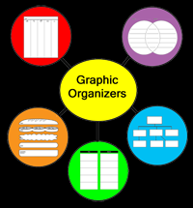

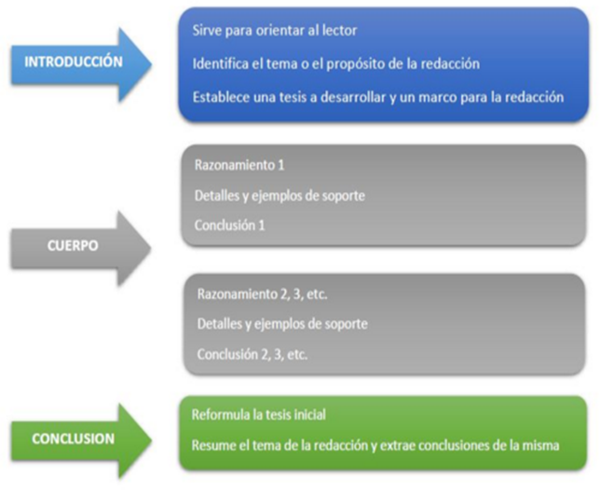




Slide 9
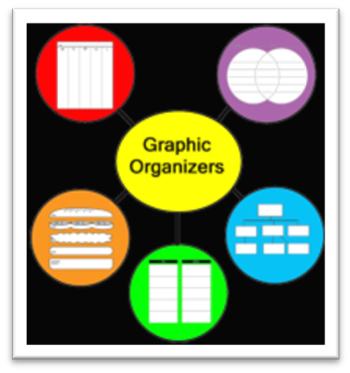
Task 2
¿Qué organizador te ayuda a... ?
Describir personajes, relaciones, situaciones
Comentar
Opinar
Analizar diferencias y similitudes
Comparar
Señalar evolución y cambio

Slide 10

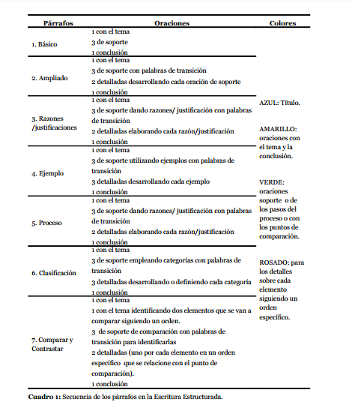
Writing frames

Slide 11

Preguntas guía
Task 3
http://padlet.com/kenia_puig/preguntasguia
Algunos ejemplos
What resources should I use to carry out this task?
What is the problem here?
Based on what I know already about this task, how can I solve this problem?
Is this correct?
How is this coming along?
If I carry on like this where am I going to get?
What should come first? What should come after?
Based on the criteria I am going to be evaluated against, how am I doing?

Slide 12


Slide 13
Meaningful feedback
Utiliza palabras neutras sin juicio de valores y centradas en el producto
Sé tan específico como sea posible
Ofrece soluciones y sugerencias
Involucra a los estudiantes en el proceso
Utiliza la coevaluación
Utiliza herramientas (rúbricas, guías de revisión etc.)

Slide 14
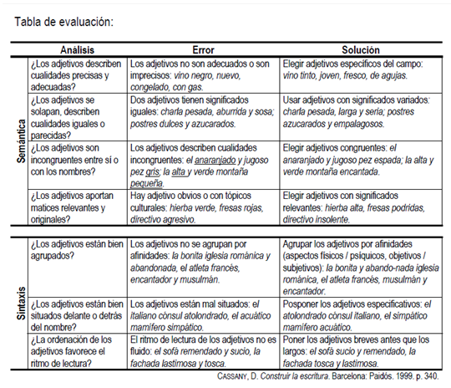
Task 4
En parejas utilizad la guía de revisión para evaluar y revisar los párrafos

Slide 15
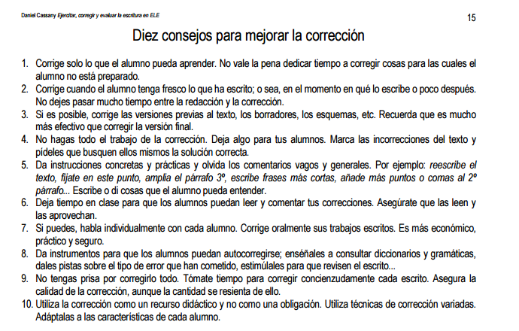

Slide 16
ICT tools
http://popplet.com/
https://www.storyjumper.com/
http://freemind.sourceforge.net/wiki/index.php/Main_Page
https://padlet.com/
https://www.edmodo.com/

Slide 17
Back to our objectives
To develop an understanding of how to support writing in the MFL classroom
To explore approaches and methodologies to scaffold writing
But remember…

Slide 18

In the end the stabilisers have to come off

Slide 19





087-7415278
Kenia.Puig@Languagesinitative.ie
https://www.facebook.com/LanguagesInitiative
@Languages_ie

